Slide 1
Project Scope and Introduction
Background:
On page 5 of The Destructionists (2022), Washington Post columnist Dana Millibank wrote: “Republican lawmakers and opinion leaders, amplified by Fox News, have overwhelmingly succeeded in deterring their followers from getting the Covid-19 vaccine by promoting disinformation about imagined dangers of the inoculations. As a result, the Covid death rate in the most pro-Trump decile of America (as measured by counties’ vote share for Trump in 2020) is now nearly six times [original emphasis] the death rate in the most anti-Trump decile.”
Millibank does not cite a source for the latter claim concerning COVID-19 mortality differences among decile-groups of support for Donald Trump in the 2020 presidential election. Having previously queried CDC COVID-19 mortality/hospitalization data and 2020 electoral outcomes data, I decided to create a short project in SQL and R to evaluate Millibank’s claim: COVID-19 death rate—presumably measured by per capita death attributable to SARS-Cov-2 infection—among counties in the top decile of GOP-voting counties during the 2020 presidential elections was 600% of the top decile of Democrat-voting counties during the same election.
Results:
Publicly available data covering demographic, public health, and presidential vote-count totals for each US county do not support Millibank’s latter claim. Regarding the former claim—that conservative political messaging deterred GOP voters from receiving the COVID-19 vaccine—Spearman’s Ranked Correlation suggests a negative relationship between county-level voting support for Donald Trump and vaccination rates among all studied age groups.

Slide 2
COVID Epidemiological Data and County-Level Voting Behavior: Decile Grouping

Slide 3
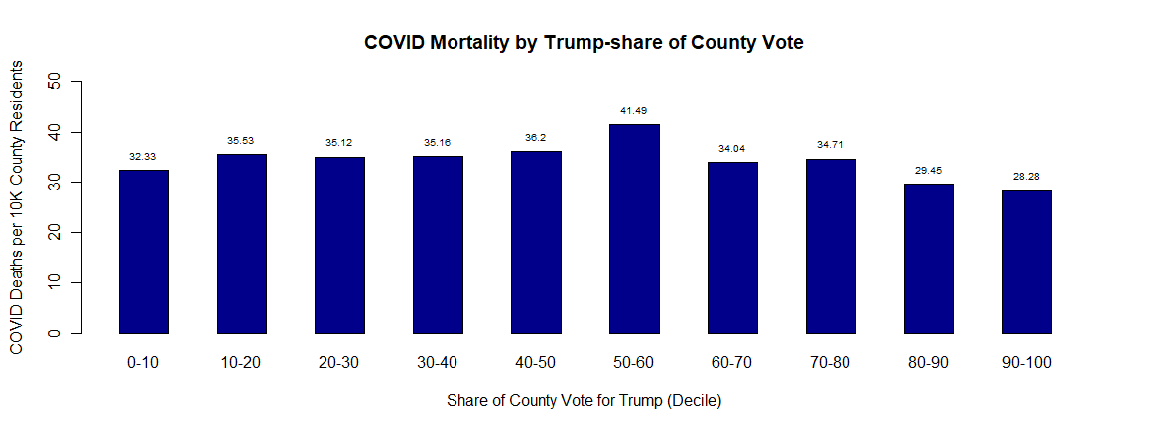
COVID Mortality Rate, Mortality Rate from all Causes, and Median Age

Slide 4
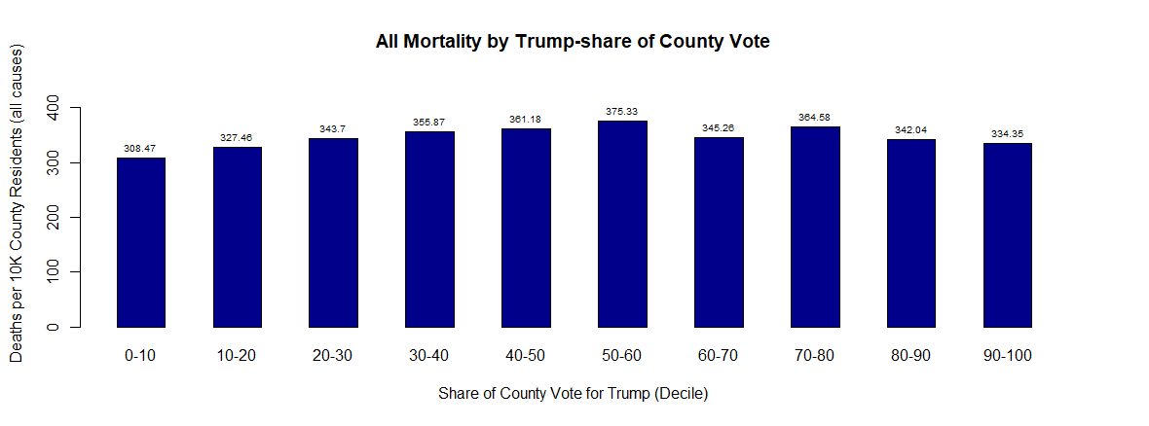
COVID Mortality Rate, Mortality Rate from all Causes, and Median Age

Slide 5
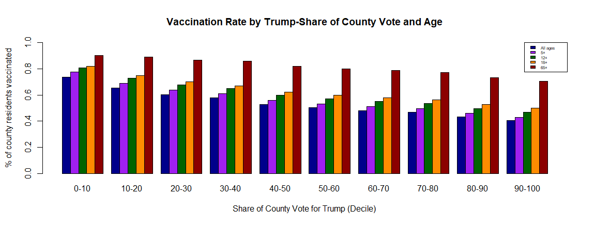
COVID-19 Vaccination by Age and Voting Behavior

Slide 6
COVID Epidemiological Data and County-Level Voting Behavior: Linear Correlation

Slide 7
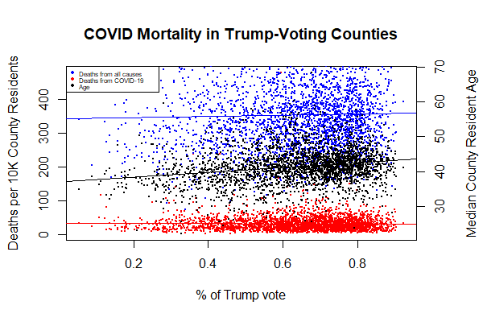
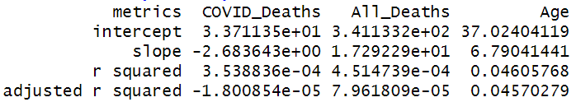
COVID Mortality Rate, Mortality Rate from all Causes, and Median Age

Slide 8
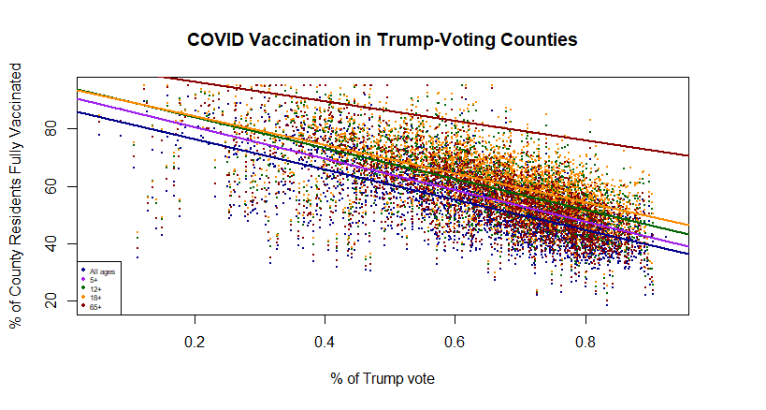
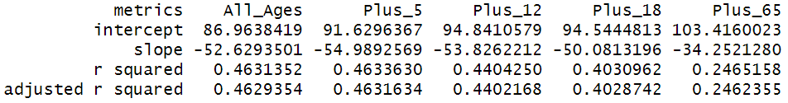
COVID-19 Vaccination by Age and Voting Behavior

Slide 9
COVID Epidemiological Data and County-Level Voting Behavior: Pearson’s and Spearman’s

Slide 10
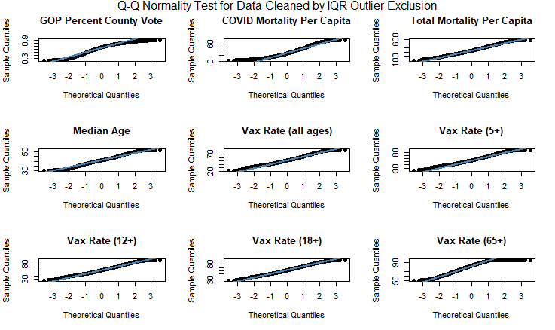
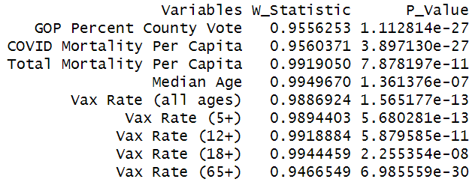
Testing Data for Pearson’s Correlation
Remove outliers using both the IQR method and the Z-Score method
All variables must satisfy normality requirements (Q-Q Plots and Shapiro-Wilks Test)
Shapiro-Wilks Normality Test

Slide 11
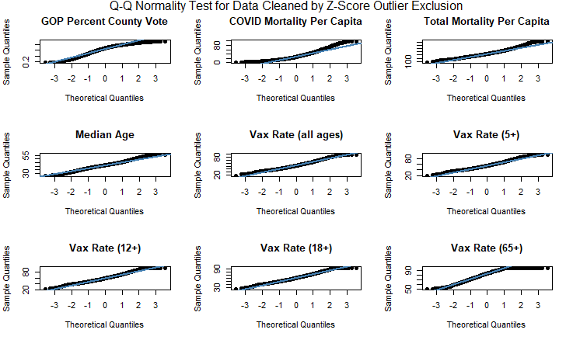
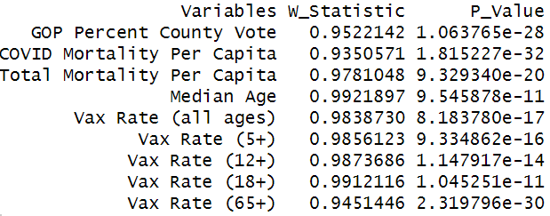
Testing Data for Pearson’s Correlation
Remove outliers using both the IQR method and the Z-Score method
All variables must satisfy normality requirements (Q-Q Plots and Shapiro-Wilks Test)
Shapiro-Wilks Normality Test

Slide 12
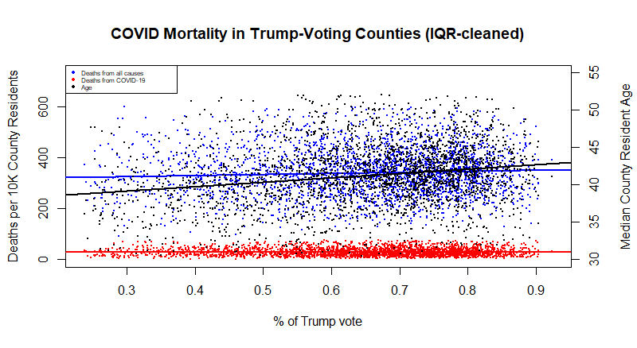
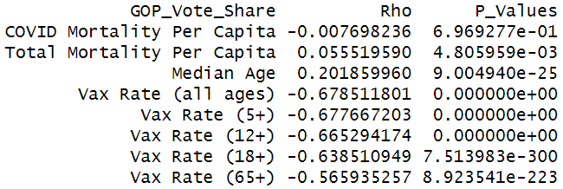
Spearman’s Ranked Correlation: COVID Mortality and Age
As all variables have failed the Shapiro-Wilk normality test using both outlier-exclusion methods, a nonparametric alternative may help us determine whether our continuous data variables feature significant monotonic relationships
Spearman’s Ranked Correlation

Slide 13
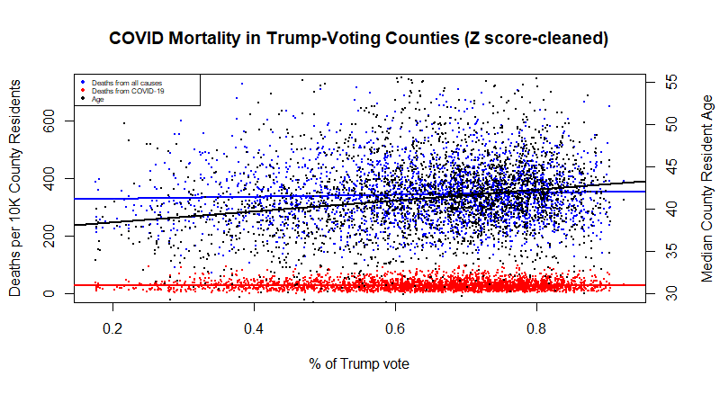
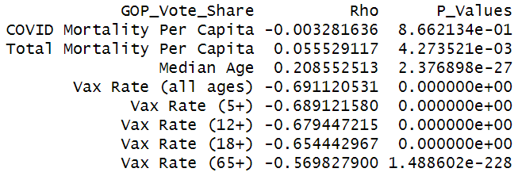
Spearman’s Ranked Correlation: COVID Mortality and Age
As all variables have failed the Shapiro-Wilk normality test using both outlier-exclusion methods, a nonparametric alternative may help us determine whether our continuous data variables feature significant monotonic relationships
Spearman’s Ranked Correlation

Slide 14
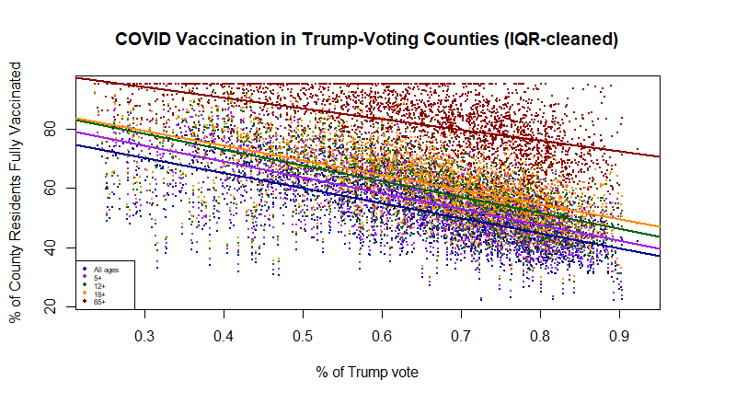
Spearman’s Ranked Correlation: COVID Vaccination by Age Group
As all variables have failed the Shapiro-Wilk normality test using both outlier-exclusion methods, a nonparametric alternative may help us determine whether our continuous data variables feature significant monotonic relationships
Spearman’s Ranked Correlation

Slide 15
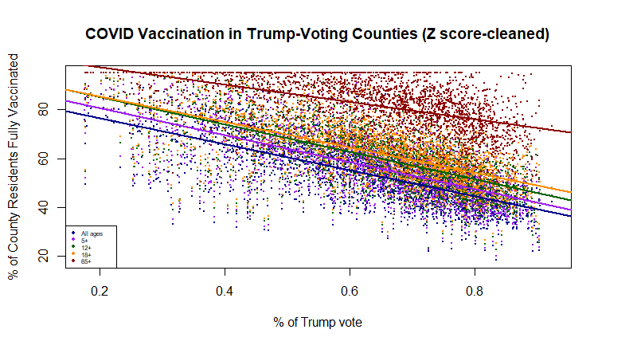
Spearman’s Ranked Correlation: COVID Vaccination by Age Group
As all variables have failed the Shapiro-Wilk normality test using both outlier-exclusion methods, a nonparametric alternative may help us determine whether our continuous data variables feature significant monotonic relationships
Spearman’s Ranked Correlation

Slide 16
Source Data
CDC COVID-19 Death Data and Resources
CDC COVID-19 Vaccinations in the United States, County
US Census Bureau County Population by Characteristics: 2020-2021
GitHub: tonmcg/US_County_Level_Election_Results_08-20

